Slide 1
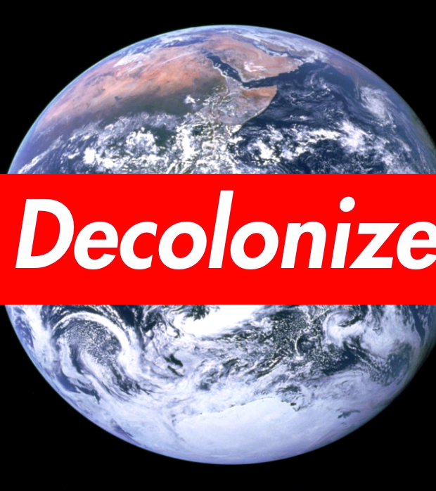
Exploring Decolonization at MC: Engaging and Empowering Students

Slide 2
Outcomes
Reflect on student feedback to identify ways to empower and engage students
Identify ways students can take an active role in decolonizing higher education at MC

Slide 3
Recap: What is decolonization?
Decolonization is “the process of deconstructing colonial ideologies of the superiority and privilege of Western thought and approaches. Decolonization involves valuing and revitalizing Indigenous knowledge and approaches and weeding out Western biases or assumptions that have impacted Indigenous ways of being” (Cull et al., 2018, p. 7).
Cull, I., Hancock, R. L. A., McKeown, S., Pidgeon, M. & Vedan, A. (2018). Pulling together: A guide for front-line staff, student services, and advisors. Victoria, BC: BC campus. https://opentextbc.ca/indigenizationfrontlineworkers/

Slide 4
Recap from previous workshop
Ask questions that promote critical thinking about the content
Address the knowledge-power dynamic
Engage student voices
Adopt alternative assessment techniques
Get to know students’ names and build relationships
Engage in self-reflection
Teach about decolonization
Offer choices
Change the structure of the room

Slide 5
Indigenous Education Values the Student Voice
“The needs of the whole student is the base consideration in Indigenous descriptions of education, and the guiding principle in Indigenous conceptions of student achievement.”
“…student voice/experiences are recognized as integral to the construction of active knowledge”
People for Education. (2022). Embracing Indigenous worldview and quality learning environments. Website. https://peopleforeducation.ca/report/what-matters-in-indigenous-education/#chapter4

Slide 6
Integrate opportunities for student feedback
Invite student feedback that address decolonization principles. For example:
Are multiple voices or perspectives represented in the content? If not, please suggest which voices are missing.
Do you have questions about how/why the content was chosen?
Consider the feedback from students when planning subsequent classes and assignments, and acknowledge how you used the feedback

Slide 7
How do you solicit feedback from your students, and how do you use that feedback?
Post responses in chat

Slide 8
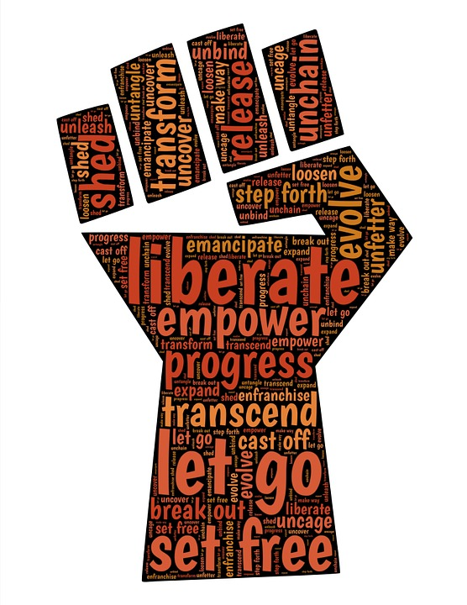
How to Engage and Empower Students to Promote Decolonization Practices
Syllabus statement
Use storytelling to share knowledge
Student passion projects
Service Learning

Slide 9
Syllabus Statement
Include a statement in the syllabus that acknowledges decolonization and the importance of students’ voices. The statement can address the following:
what decolonization means
the value of student voices
resources in the college and community that give students the opportunity to engage in decolonization work (Note: We can build a collection of resources together.)

Slide 10
What resources are you aware of (at the college or beyond) that could engage students in decolonization work?
Post responses in chat

Slide 11
Incorporate Storytelling
Indigenous education values sharing knowledge through storytelling.
Invite students to share their stories and experiences to promote receptive listening and empathy.
Use students' stories of lived experiences as classroom material by connecting it to the course outcomes.
Set guidelines to facilitate student sharing in a judgment-free environment.
(See page 5 of Engaging Adult Learners for more details about narrative learning.)

Slide 12
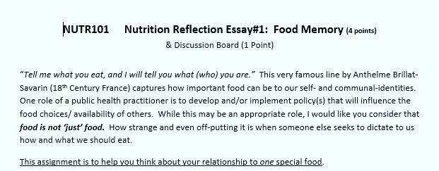
NUTR101 Nutrition Reflection Essay#1: Food Memory (Professor Sara Ducey)

Slide 13
NUTR101 Nutrition Reflection Essay#1: Food Memory (Professor Sara Ducey)

Slide 14
Post in Chat
Consider the example from the nutrition course. What food memory story would you tell? What type of story could you invite students to share for your course, and how could those stories be used for further learning?

Slide 15
Passion Projects
Passion Projects “are designed to tap into the things that make our students’ heart race, their eyes light up, and their engagement increase to maximum levels.” (Aierstock, E., 2019)
(Source: Aierstok, E. (2019). How I use passion projects to deepen my students’ relationship with reading. How I Use Passion Projects in Independent Reading - WeAreTeachers
Passion projects are “project-based learning activit[ies] in which students research any topic they are passionate about and create a project to share with the class, the school, the community....the world!”
Google popularized passion projects through by allowing employees to spend 20% of work time on a project of personal interest. (Some companies, allow 60 minutes per week for Genius Hour)
(Source: Passion Project. (n.d.). https://sites.google.com/camas.wednet.edu/passionproject/home)

Slide 16
Passion Projects
Process:
Choice (connect to standards of learning)
Deep Learning
Progress Checks
Let Go
Celebrate
(Source: Aierstok, E. (2019). How I use passion projects to deepen my students’ relationship with reading. https://www.weareteachers.com/passion-projects-independent-reading/#:~:text=Explain%20that%20a%20passion%20project%20is%20a%20project,passion%20to%20reflect%20your%20understanding%20of%20your%20novel%3F)
Process:
Brainstorming
Topic approval
Research
Document process
Project Presentation
(Source: Passion Project. (n.d.). https://sites.google.com/camas.wednet.edu/passionproject/home)

Slide 17
What would you have to consider if implementing a passion project in your course?
Post responses in chat
This Photo by Unknown author is licensed under CC BY.

Slide 18
Service Learning: Decolonized Service Learning
Rethinking the idea of “service” by viewing members of the community as teachers and allowing the narrative to emerge from that community (versus an exploitative or “saviorism” approach)
[Cornell ILR Buffalo Co-lab. (2020). Decolonizing service learning. YouTube video. https://youtu.be/x_QbvYc-J7I?t=4206]
Coalitional activism, which “encourages students to think about how oppression on the basis of race, gender, and class function together to suppress voices from the margins” and “think about ways to build coalitions with others, then act”
[Mills College. (2020). Challenging classroom colonialism and the problem with “decolonizing education.” Blog. https://online.mills.edu/blog/decolonizing-education/)
Relational learning, “the active process of co-constructing knowledge not only in the classroom but outside in the world.”
[Taos Institute. (2022). Relational learning in education. https://www.taosinstitute.net/resources/relational-learning-in-education.]

Slide 19
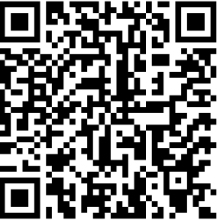
Service Learning
MC has a service learning program led by part-time services learning coordinators on each campus. Take a few minutes to review the program page.
https://www.montgomerycollege.edu/life-at-mc/student-life/service-learning-civic-engagement.html

Slide 20
How might you use MC’s resources to engage students in a decolonized service learning project?
Post responses in chat

